Slide 1
Introduction to Spatial Data Management
CSE532: Theory of Database Systems
Fusheng Wang
Department of Biomedical Informatics
Department of Computer Science
Based on Michael Gertz’s course slides at UC Davis

Slide 2
Spatial Data
Spatial Data
Data with an associated spatial location (with respect to a given reference frame)
Information about the location and shape of, and relationships among, geographic features, usually stored as coordinates and topology
Reference Frames
Reference frames are basically the different perspectives of the viewer to describe physical quantities (e.g., position, velocity) Coordinate systems are the different ways to describe physical quantities in these perspectives
Geographic/Geospatial Data
Data whose underlying reference frame is the Earth’s surface
Geospatial information concerns phenomena above, on and below the Earth’s surface
The notions “spatial data” and “geospatial data” are often used interchangeably

Slide 3
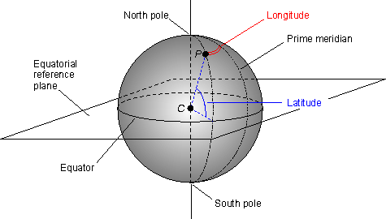
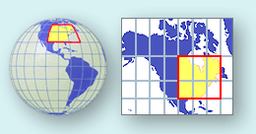
Coordinate System
Coordinate System (CS) – provides a frame of reference to define locations
Geographic CS – Used for 3D (sphere or globe), locations defined by latitude and longitude, usually in decimal degrees
Projected CS – Used for 2D (maps), locations defined by x,y measured from some origin (0,0), usually in meters, sometimes in feet
Latitude and Longitude
Based on the Earth’s rotation and center of mass, and the Greenwich Meridian
Notes:
Greenwich Meridian

Slide 4
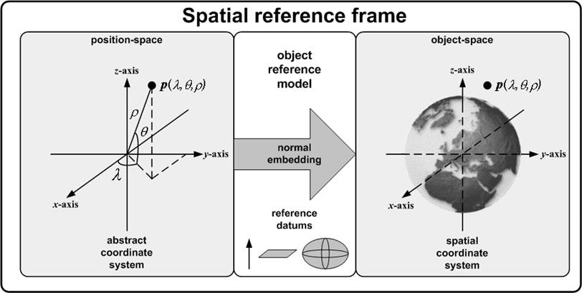
Spatial Data: Spatial Reference Frame
Notes:
A spatial reference frame is a means of specifying a spatial coordinate system for an object space.
The spatial reference frame concept uses an object reference model to specify a normal embedding.
That normal embedding combined with an abstract coordinate system comprises the spatial
coordinate system.

Slide 5
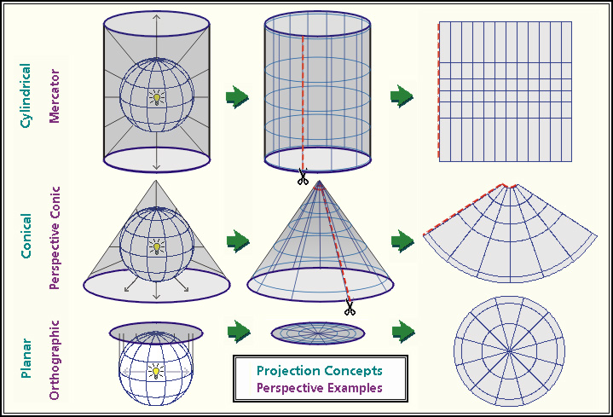
Map Projections
Notes:
project the Earth’s surface onto a plane, rather than deal with the curved surface

Slide 6
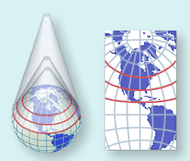
Conic Projections
Conceptualized as the result of wrapping a cone of paper around the Earth
Standard Parallels occur where the cone intersects the Earth
The Lambert Conformal Conic projection is commonly used to map North America
On this projection lines of latitude appear as arcs of circles, and lines of longitude are straight lines radiating from the North Pole

Slide 7
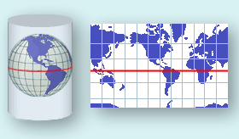
Cylindrical Projections
The Mercator projection is the best-known cylindrical projection
The cylinder is wrapped around the Equator
The projection is conformal
At any point scale is the same in both directions
Shape of small features is preserved
Features in high latitudes are significantly enlarged

Slide 8
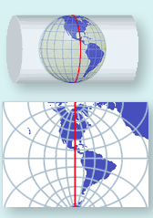
The Universal Transverse Mercator (UTM) Projection
A type of cylindrical projection
Implemented as an internationally standard coordinate system
Initially devised as a military standard
Uses a system of 60 zones
Maximum distortion is 0.04%
Transverse Mercator because the cylinder is wrapped around the Poles, not the Equator

Slide 9
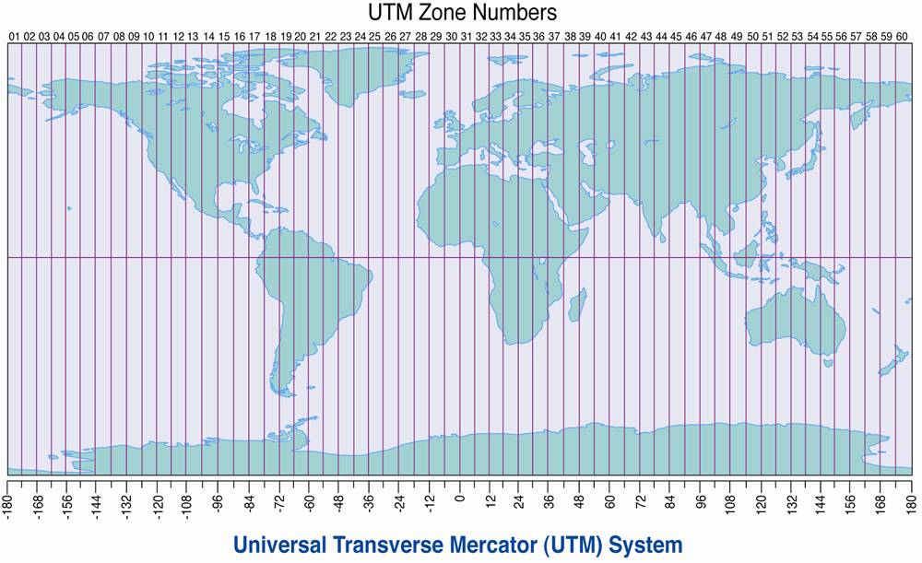
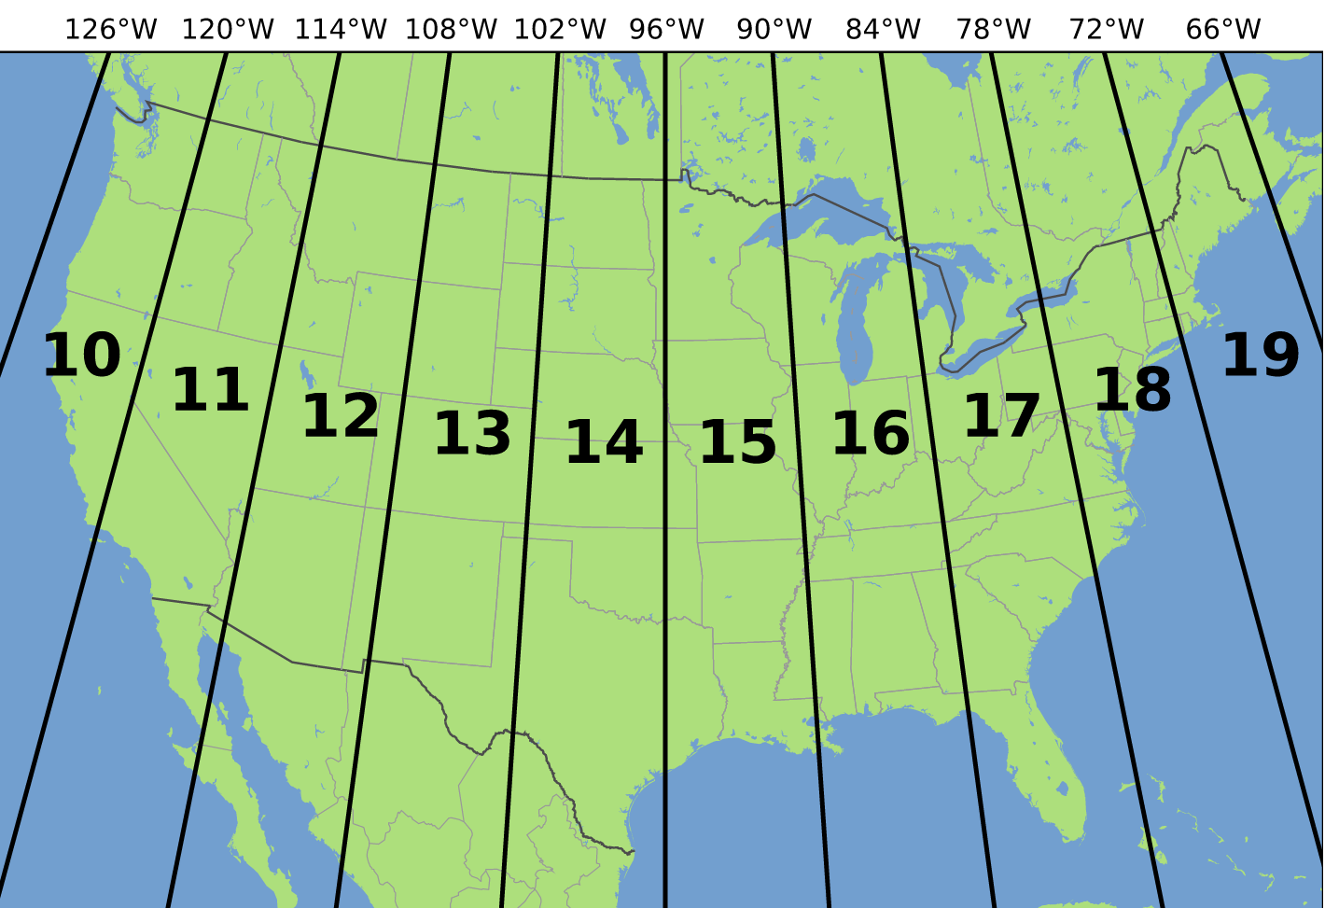
The Universal Transverse Mercator (UTM) Projection
UTM is a grid-based method of specifying locations on the surface of the Earth with 2-D Cartesian coordinate system
UTM divides the surface of Earth into 60 zones (6° width)
A position on the earth can be represented as an easting and northing coordinate pair. e.g.:
Toronto CN Towner: zone 17; grid position: 630084m E 4833438m N
Notes:
墨卡托方位法

Slide 10
US UTM Zones
The UTM system divides the Earth between 80°S and 84°N latitude into 60 zones, each 6° of longitude in width

Slide 11
Converting Georeferences
(longitude latitude) to UTM coordinate
Street addresses must be converted to coordinates for mapping and analysis
Using geocoding functions
Placenames can be converted to coordinates using gazetteers

Slide 12
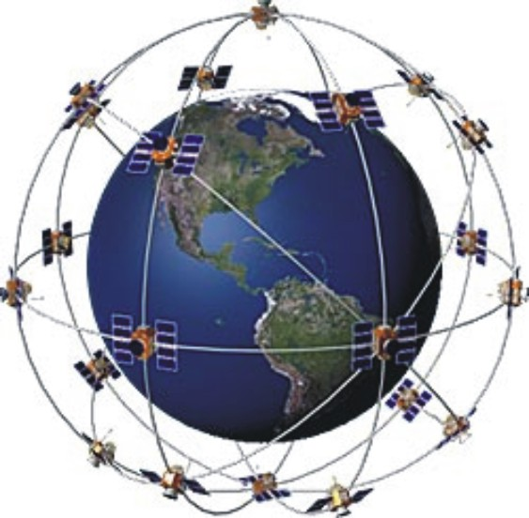
The Global Positioning System (GPS)
Allows direct, accurate measurement of latitude and longitude
Accuracy of 10m from a simple, cheap unit
Differential GPS capable of sub-meter accuracy
Sub-centimeter accuracy if observations are averaged over long periods
Consists of a system of 24 satellites, 4 satellites/orbit
Position in a receiver is determined by precise calculations from:
the satellite signals,
the known positions of the satellites
the velocity of light
Accuracy depends on the number of satellites
and their positions

Slide 13
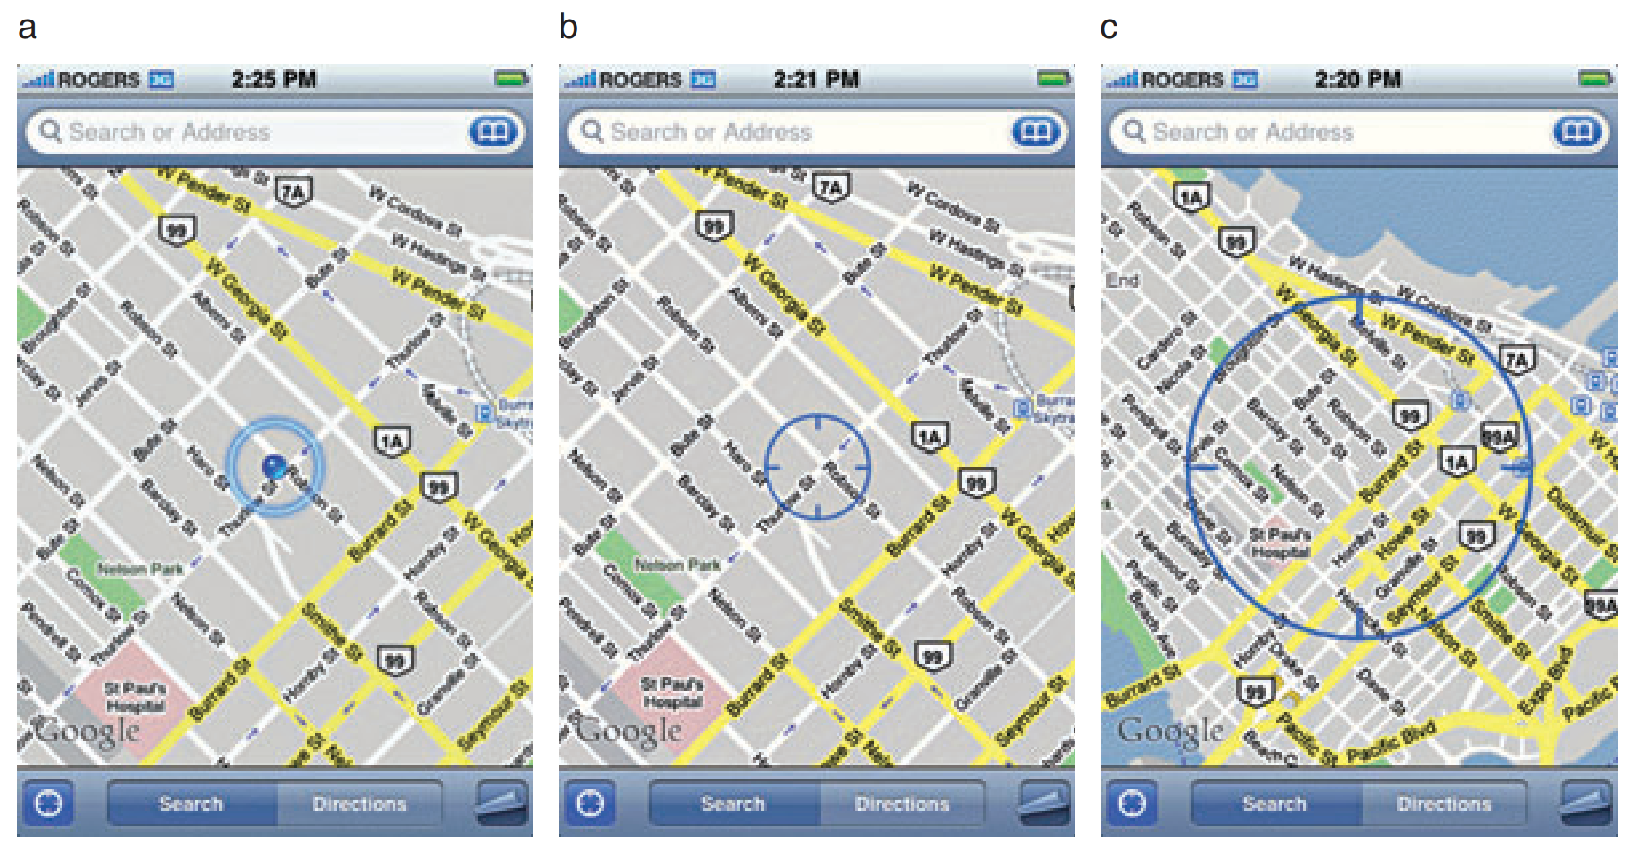
Smart Phone Locational Services
Smart phones in fact use more than GPS to locate you. They employ a hybrid locational system combining three separate technologies:
Assisted GPS (A-GPS)
WiFi positioning
Cellular network positioning
Assisted GPS
(A-GPS)
WiFi
Cellular Network
Notes:
http://www.paulzandbergen.com/PUBLICATIONS_files/Zandbergen_TGIS_2009.pdf
https://www.macworld.com/article/1159528/smartphones/how-iphone-location-works.html
https://communityhealthmaps.nlm.nih.gov/2014/06/30/how-accurate-is-the-gps-on-my-smartphone/

Slide 14
Spatial Data
At the conceptual level, a geographic object corresponds to an entity of the real world and has two components:
A set of alphanumeric attributes, also called descriptive attributes,
A spatial component, which may embody both geometry (e.g., location, shape) and topology (spatial relationships with other objects)
The isolated spatial component of a geographic object is called spatial object

Slide 15
Spatial Data
Spatial data may be obtained from
Primary data collections in the field where data is directly collected from field surveys; GPS helps in determining point locations; data is collected remotely through remote sensing techniques
Main problem in primary data collection: delimiting geographic objects and associating thematic attributes with objects
Digitized from existing maps
Maps come with a scale
A reference system is needed to represent geographic coordinates, which involves a choice of a map projection (e.g., Mercator, UTM)
Collected from your smart phone!

Slide 16
What Is Special about Spatial?
Traditional Database Management Systems (DBMSs) are very good in managing non-spatial data, such as strings, numbers, dates. They provide for
efficient access to and modification of data through declarative query languages and access paths
transaction management and concurrency control
persistence and recovery in case of failures
access control and security mechanisms
logical and physical data independence through 3-level schema architecture

Slide 17
What Is Special about Spatial? (2)
Spatial data is more complex compared to traditional (business) data. Complexities include the
modeling of space, appropriate space/geometric models and data types
complex spatial relationships that need to be managed to speed up query processing,
inadequacy of traditional access paths and (1-dimensional) index structure
Consequence: Techniques and extensions of traditional (relational) DBMSs are necessary to meet requirements of spatial data management

Slide 18
Geographic Information Systems (GIS)
A GIS is a software package to store, manage, analyze, and visualize spatial data using spatial analysis functions, such as
Search: Thematic search, search by region / coordinates, classification
Location Analysis: Buffer corridor, overlay
Terrain Analysis: Slope/aspect, catchment, drainage network
Flow Analysis: Connectivity, shortest path
Distribution Change: Detection, proximity, nearest neighbor
Spatial Analysis/Statistics: Pattern, autocorrelation
Measurements: Distance, shape, adjacency, direction, perimeter
Notes:
Wikipedia:
Geographic information systems (GIS) or geospatial information systems is a set of tools that captures,
stores, analyzes, manages, and presents data that are linked to location(s). In the simplest terms, GIS is the
merging of cartography, statistical analysis, and database technology

Slide 19
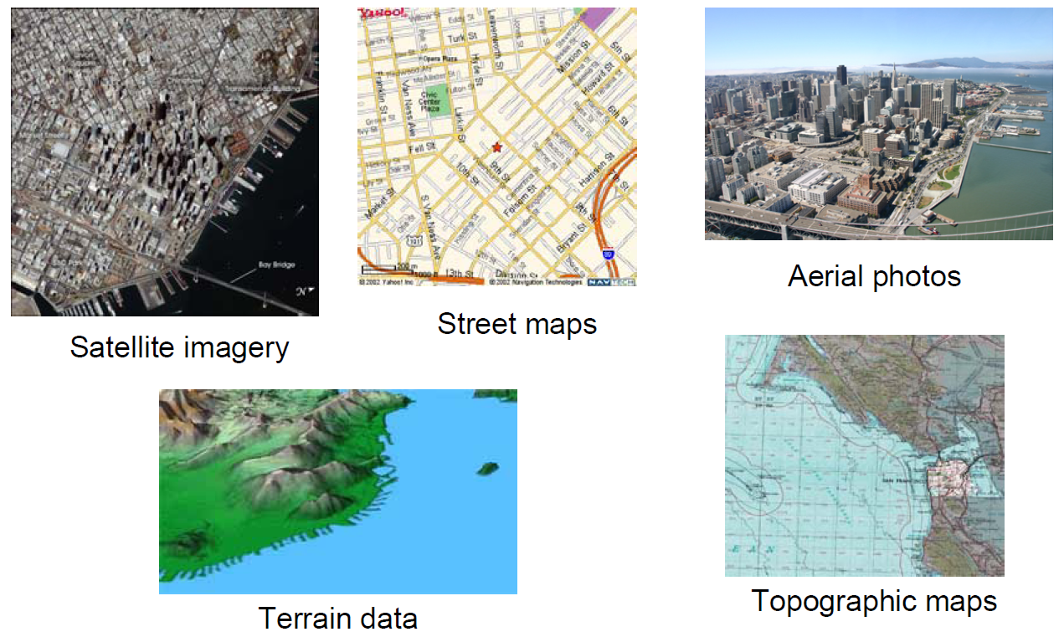
Geospatial Data
GIS are capable of managing a wide variety of spatially referenced data

Slide 20
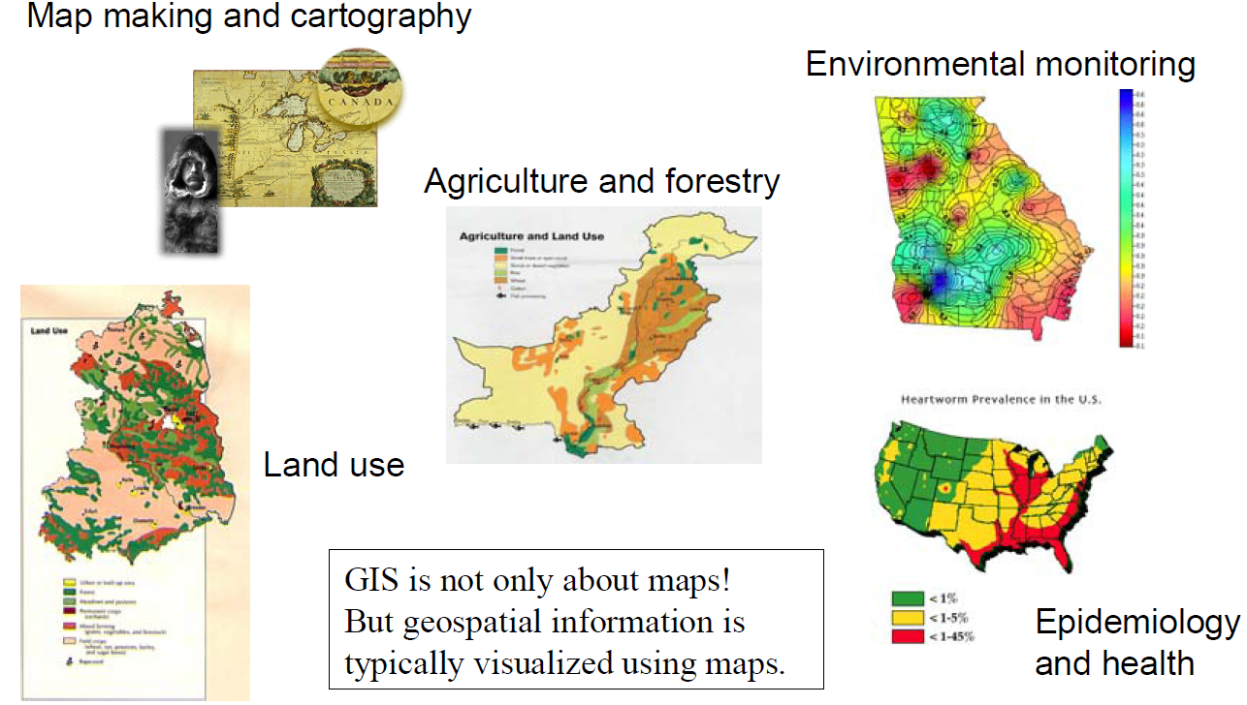
Classical GIS Applications

Slide 21
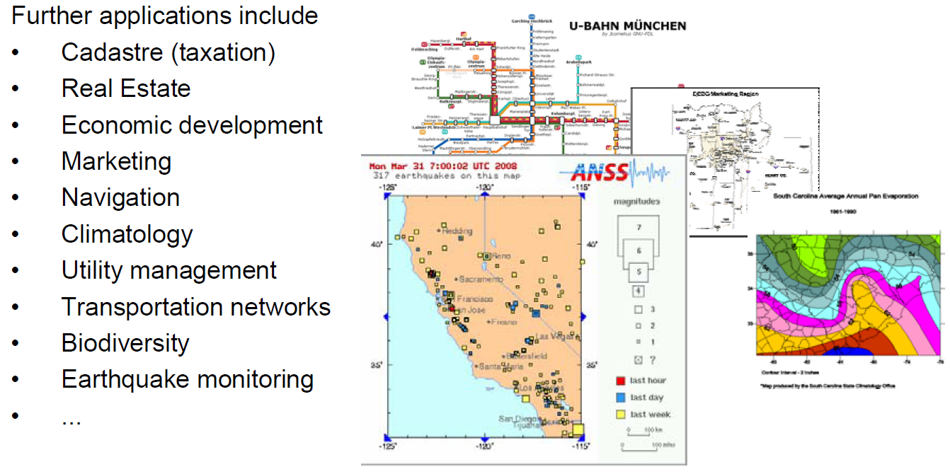
Classical GIS Applications (2)
GIS is fundamentally about solving real-world problems
Used at various levels, from specific industries and businesses to local governments to federal government to international agencies

Slide 22
Increase of Spatial Data
According to unofficial sources, 80% of the data available has a spatial component (just think about addresses, including zip codes and street names...)
Huge amounts of spatial data is delivered by Earth Observation Systems; e.g., NASA generates many terabytes of satellite image data per day
Various new services such as Google Maps, Google Earth, Here, NASA World Wind have spurred public and commercial interest in geospatial data
GIServices are a rapidly growing form of electronic commerce
Route planning, emergency and disaster management and mitigation, crime tracking, simulation of environmental effects, location-based services
Volunteer geographical information (VGI) or geo-crowdsourcing
In general, there is a need to integrate spatial information within a wide variety of contexts

Slide 23
Vocabulary in Geospatial Database Applications
Theme: geospatial information corresponding to a particular topic; similar to a relation in the relational model
When a theme is displayed, a user typically sees a map, with colors, a particular scale, a legend, …
Constructing a conceptual schema for all themes of interest is typically the first step in developing a GIS application
theme = {geographic object} // set of geographic objects
geographic object = (description, spatial object) // atomic object
| (description, {geographic-object}) // complex object
A theme thus is a set of homogeneous geographic objects (objects having the same structure or type) and is represented according to the GIS logical data model, (geographic model)
Representation of geometry and topology requires spatial data model, which can include basic types such as point (0-D), line (1-D), and region (2-D)

Slide 24
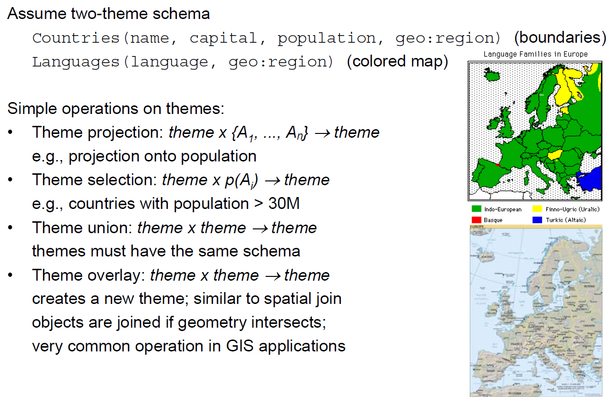
Geospatial Data Manipulation
e.g., find country regions where English is spoken.

Slide 25
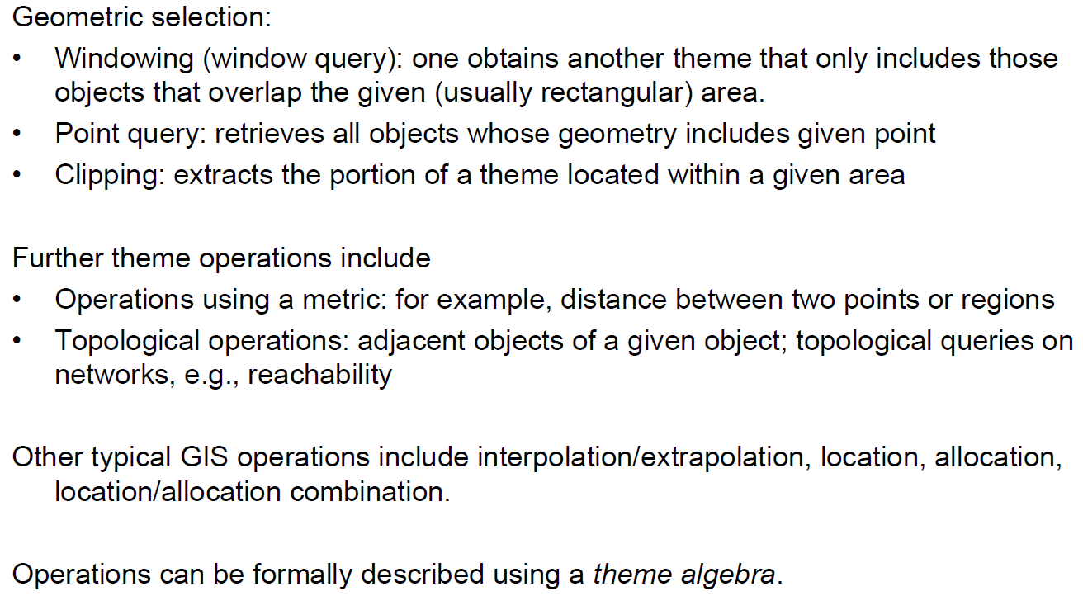
Geospatial Data Manipulation

Slide 26
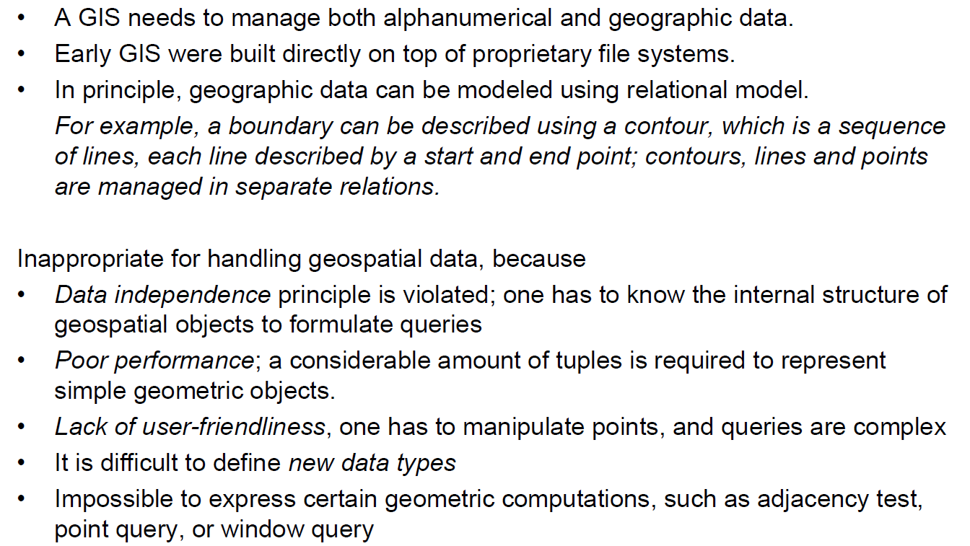
Geospatial Data Manipulation

Slide 27
Spatial Database Management Systems
A Spatial Database Management System (SDBMS) is a software package that
can work with an underlying DBMS
supports spatial data models, spatial abstract data types (ADTs) and a query language that supports operations on ADTs (in addition to traditional SQL-like operations)
supports spatial indexing, efficient algorithms for processing spatial operations, and domain specific rules for query optimization
supports efficient storage, querying, and sharing of large spatial datasets

Slide 28
Spatial Database Management Systems (2)
In general, SDBMS:
integrates representation and manipulation of geometric data with traditional data at the logical level
provides efficient support at the physical level to store and process the data
The kernel of most GIS is a Spatial Database Management System
Examples systems
ESRI’s ArcGIS, Oracle Spatial, DB2 Spatial Extender, IBM Informix Spatial Blade, SQL Server spatial support, PostGIS, mySQL spatial extensions

Slide 29
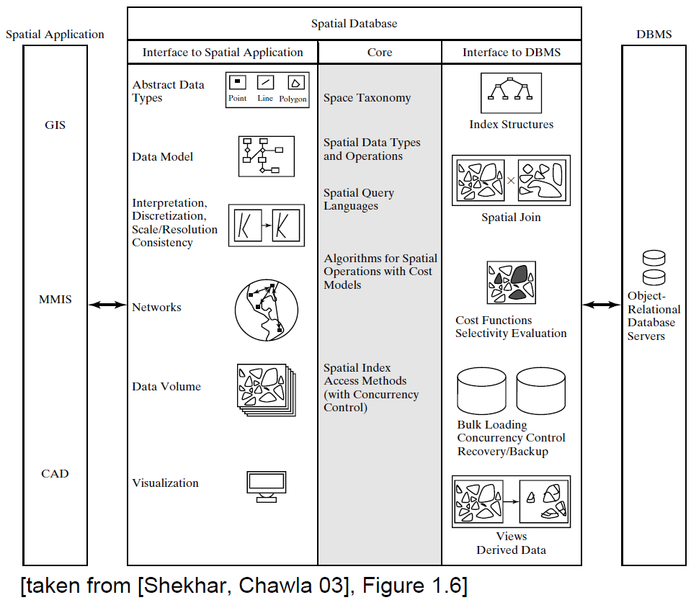
“Three Layer” Architecture

Slide 30
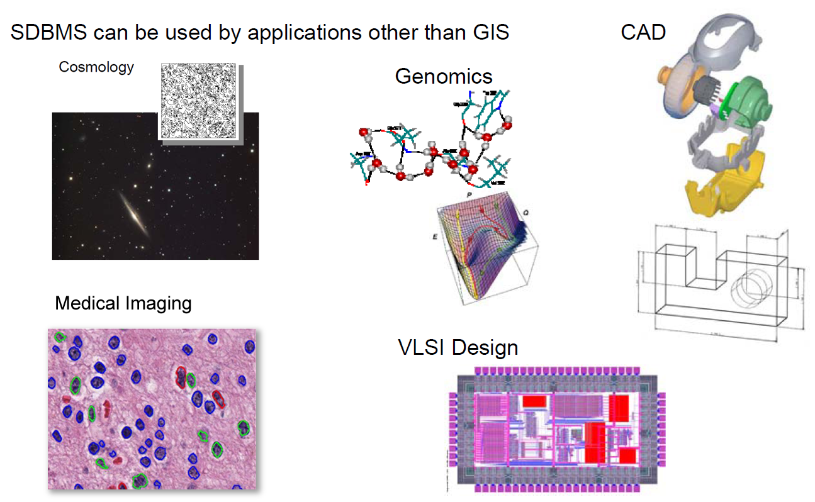
SDBMS

Slide 31
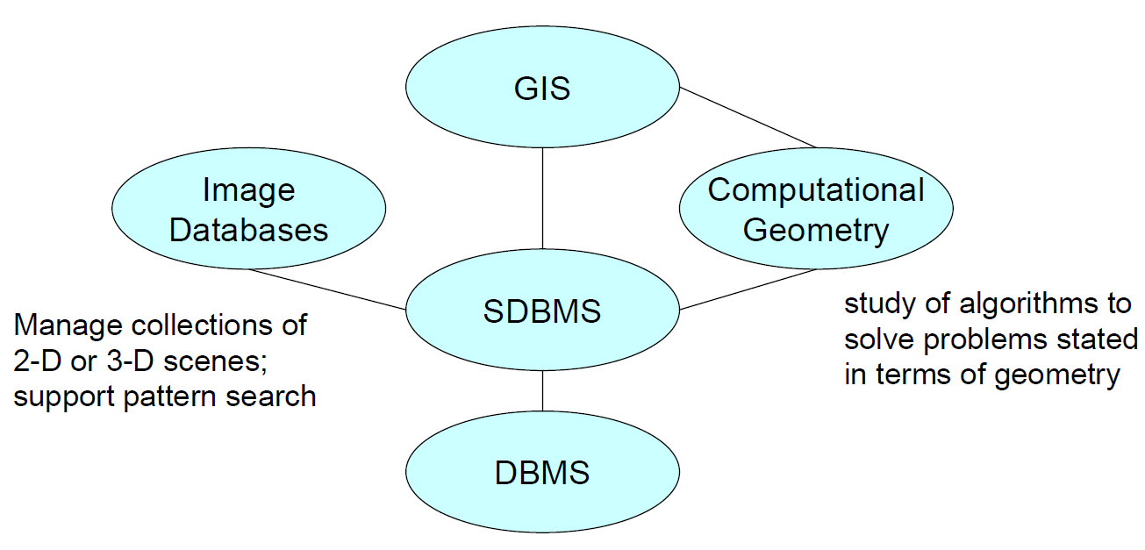
SDBMS in Context

